Slide 1

Affective Awareness Agents in Virtual Reality
Presenter- Sweta Das
Date: 20 August 2022

Slide 2
Acknowledgements
Dr. Richard Li, project supervisor and mentor, for his invaluable guidance and feedback on each stage of development, reminding the objectives of the project, providing a suitable direction and giving hints at stages of getting struck.
Mr. Chun Ho (Max) Cher, Research Assistant in Game Lab, for helping to use and understand the hardware devices in the lab at initial stages; provide valuable suggestions for capstone project as a senior.
Mr. Hinchuen (Timothy) Ng, a graduated senior, for his suggestions to write and present the capstone project.
Mr. Yat Ying (Edwin) Yu, a senior, for his important tips on managing the capstone project.
Game Lab at The Hong Kong Polytechnic University, for providing access to resources.

Slide 3
Flow of presentation
Background and Objectives
The Idea
System Design and Architecture
Recognize emotions from speech
Recognize emotions from face
Return a suitable response in addition
Demo
Results
Impact
Future improvements
Discussion
Question-Answer

Slide 4
How do you judge someone’s emotions?
Through Speech?
Through Facial Expressions?
Are you able to interpret accurately or remain unclear?

Slide 5
To add notes
Judge emotions, gets biased- either on the words or the face
Only face is deceptive
Express themselves
Interpretation of emotion
About people who may not understand emotion like those who are not well versed, disabled
Using technology to assess emotions through a balanced logical measurement of facial expr and linguistic expr.
Unbiased assessment of state of mind of person
Facial recogn software and lexical analysis
Accordingly response generated
Use cases: games, psychological counselling, metaverse development

Slide 6
Background and Objectives
“The aim is to recognise the overall emotions of a user from his or her facial expressions and speech. ”
Sub-divided as:
Recognize emotions from speech
Recognize emotions from facial expressions
Return a suitable response in addition

Slide 7


The Idea
VR program
Program’s response (actions generated as per user’s emotions)
2
User’s input (Voice, facial expressions)
1
The whole idea in 2 arrows

Slide 8
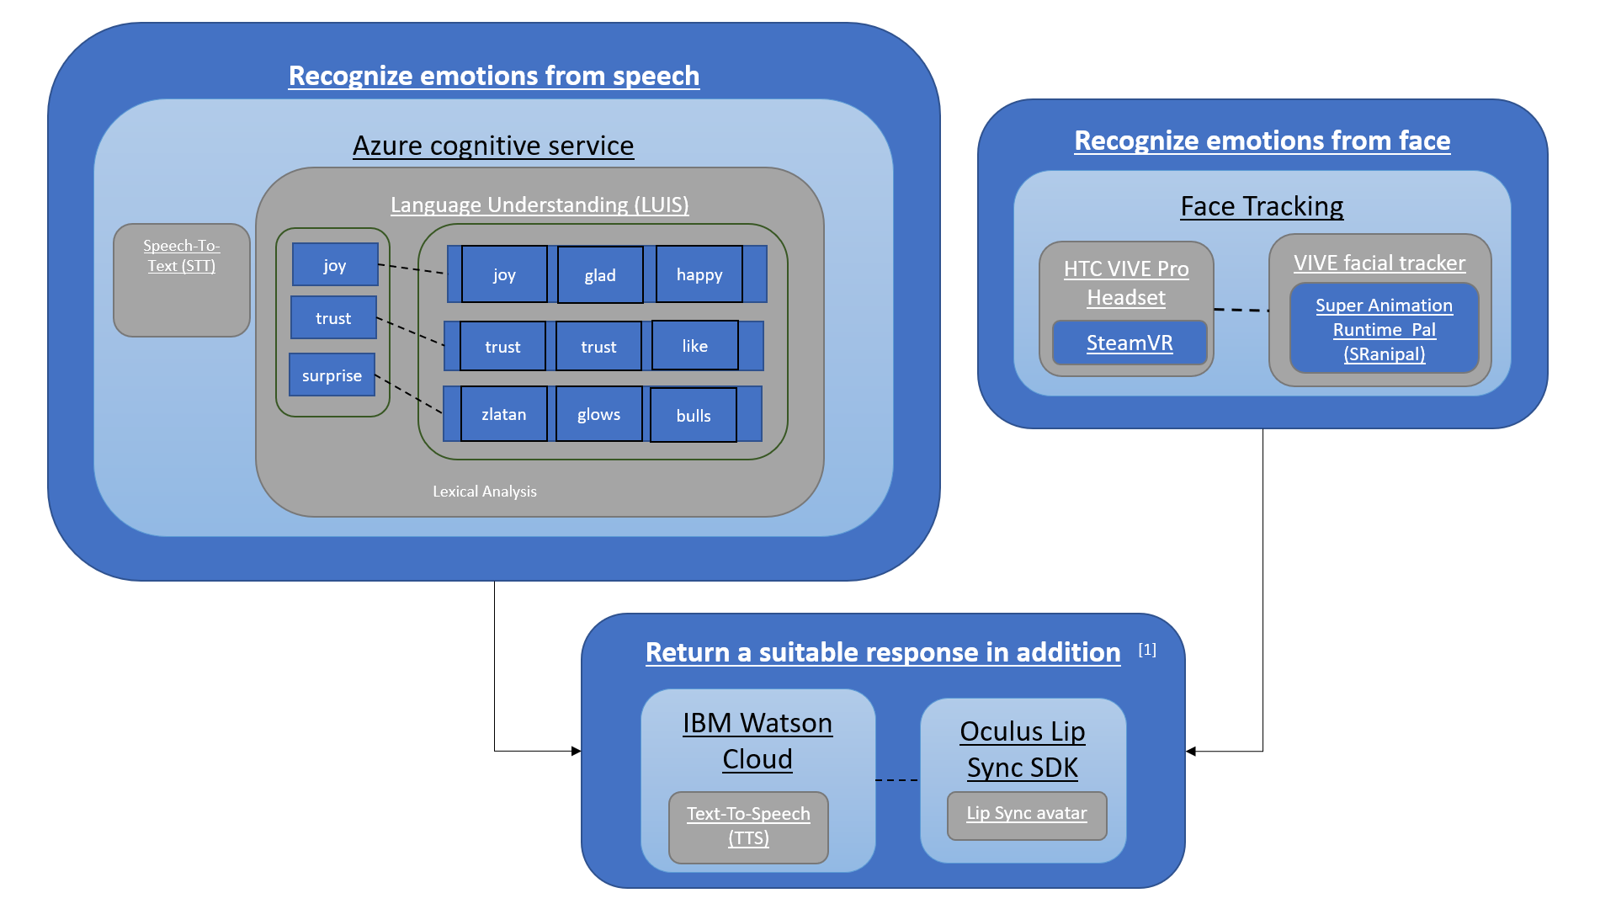
Tools and Techniques used
[1] Scott Hwang’s GitHub project for Lip sync using Oculus SDK and IBM Watson Cloud
A brief utilization of tools and techniques found

Slide 9
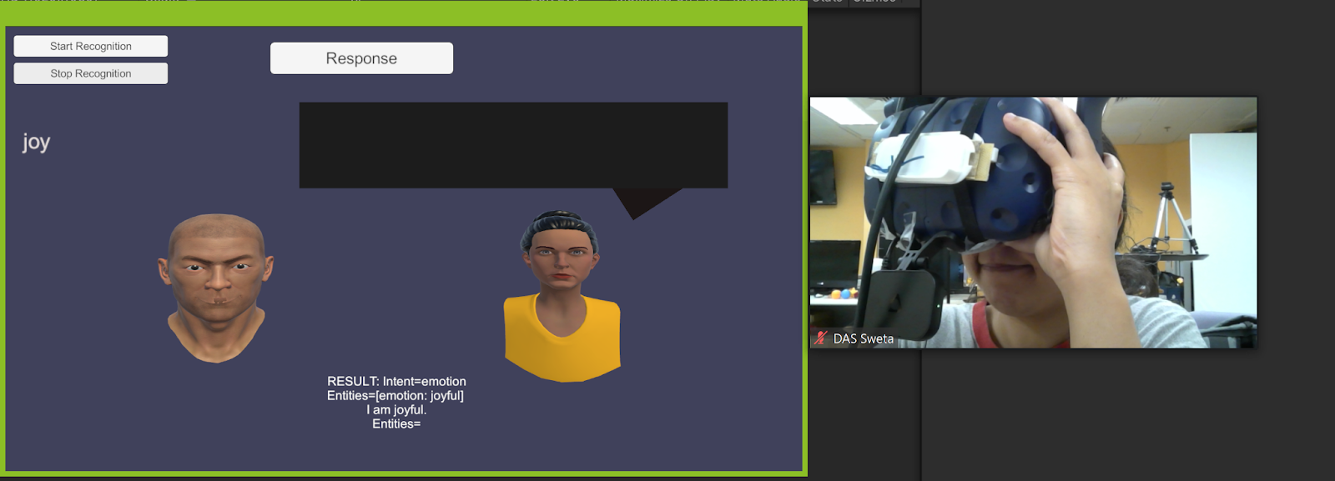
Tools and Techniques used
Facial expressions replicated by 3D model
Facial tracking set-up, only lower mouth being detected in process

Slide 10
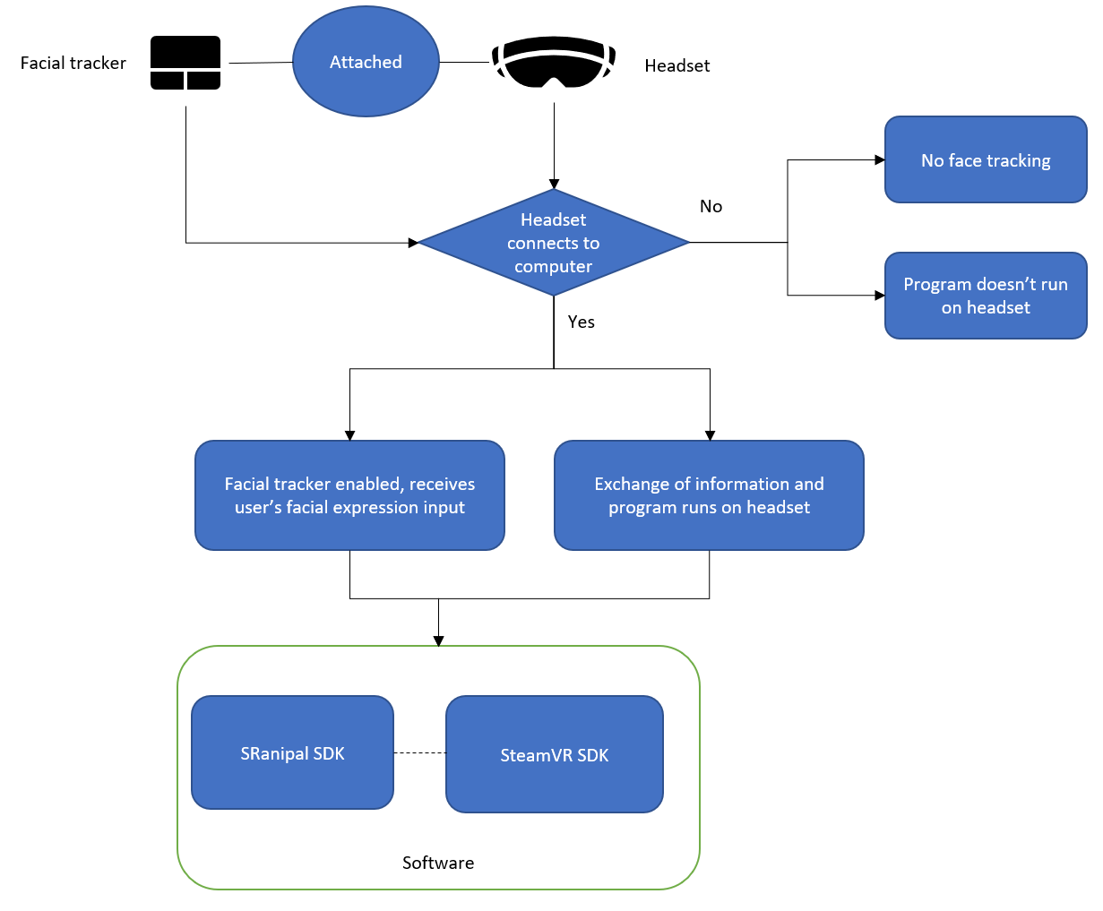
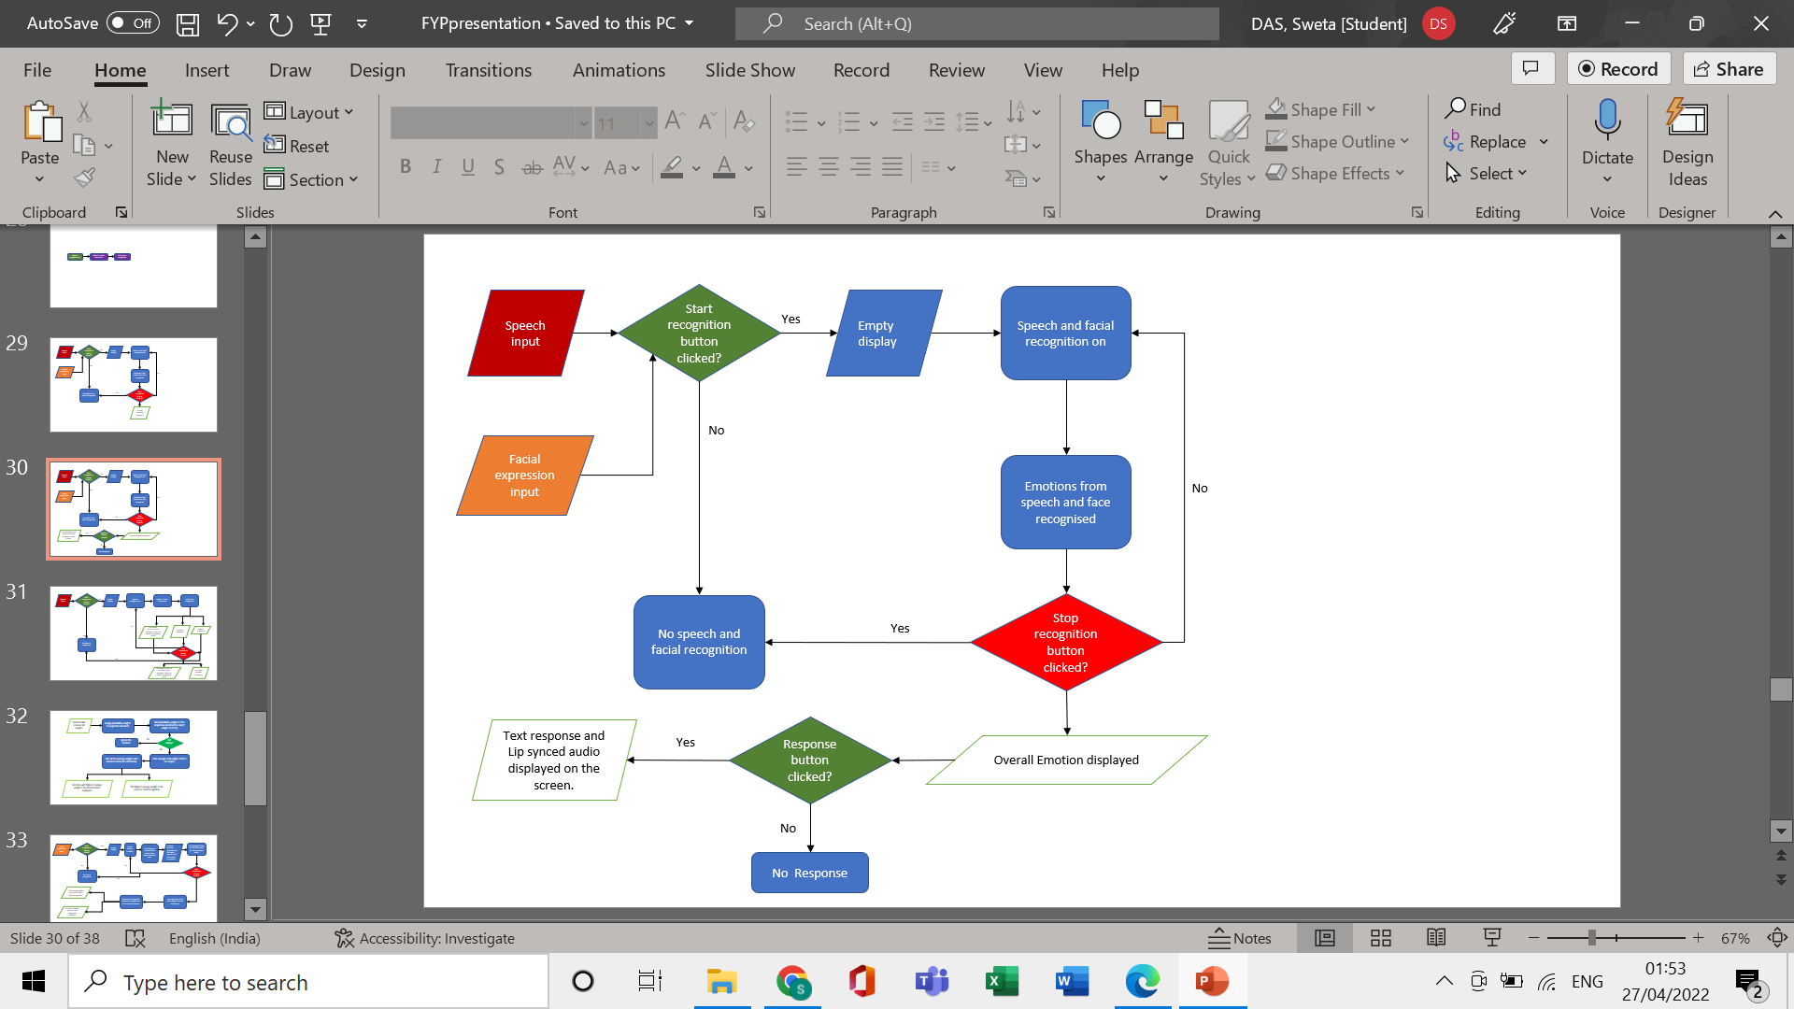
System Design and Architecture
Overall Setup
Overall Software Design

Slide 11
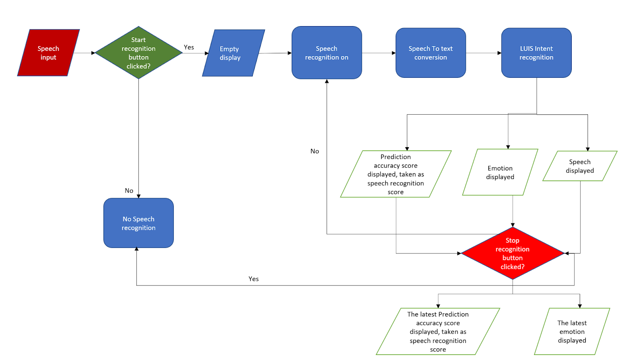
Recognize emotions from speech
Emotional recognition from speech in brief

Slide 12
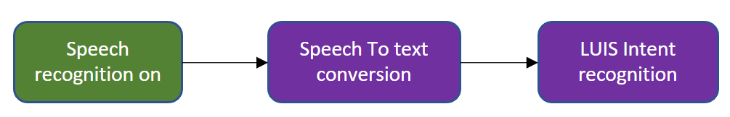
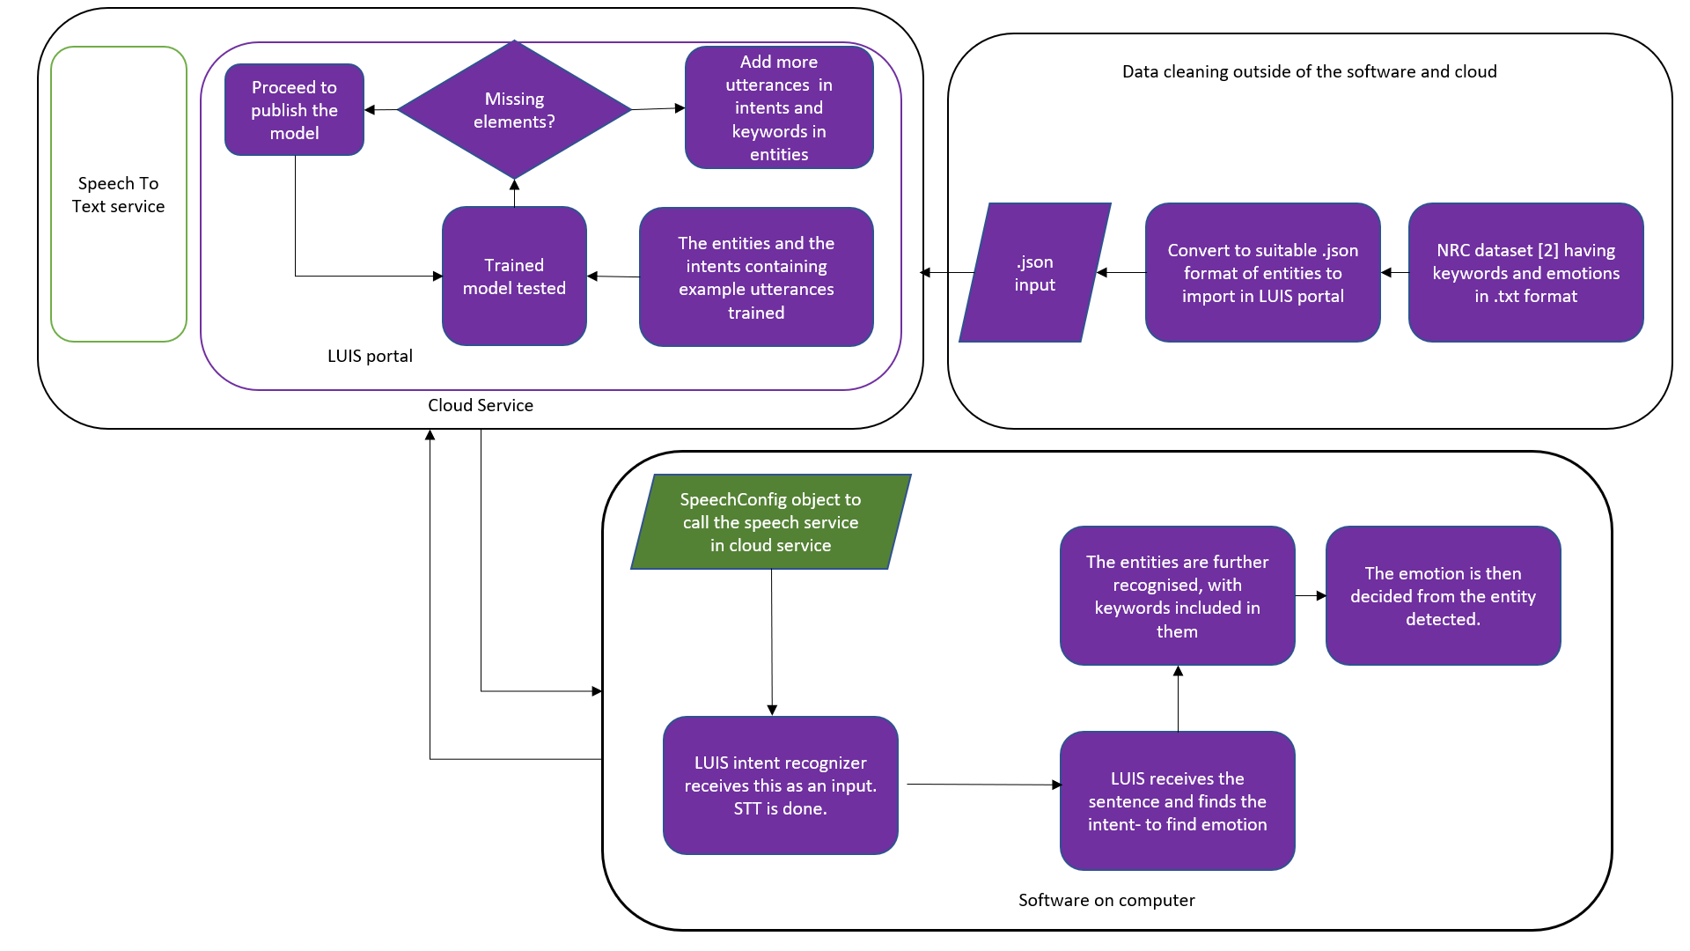
Recognize emotions from speech
In short
In detail
[2] National Research Council, Canada (NRC), which was contributed by Dr. Saif Mohammed
Cloud and software interaction

Slide 13
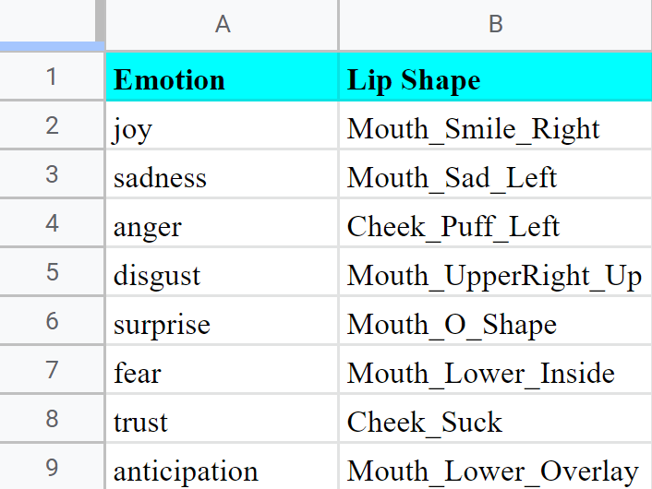
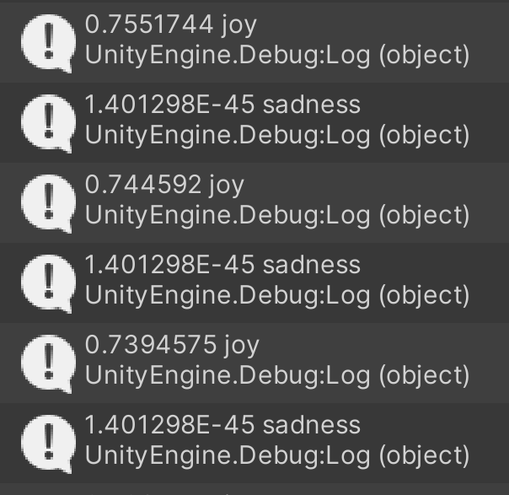
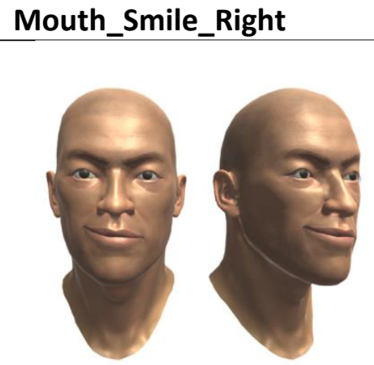
Recognize emotions from Face
Each Lip shape/expression is mapped with emotion and score is shown.
Observation: The said “weights” of each facial expression is high in range [0.5,1) when similar expression is made.
Mapping and weights of emotions with expressions

Slide 14
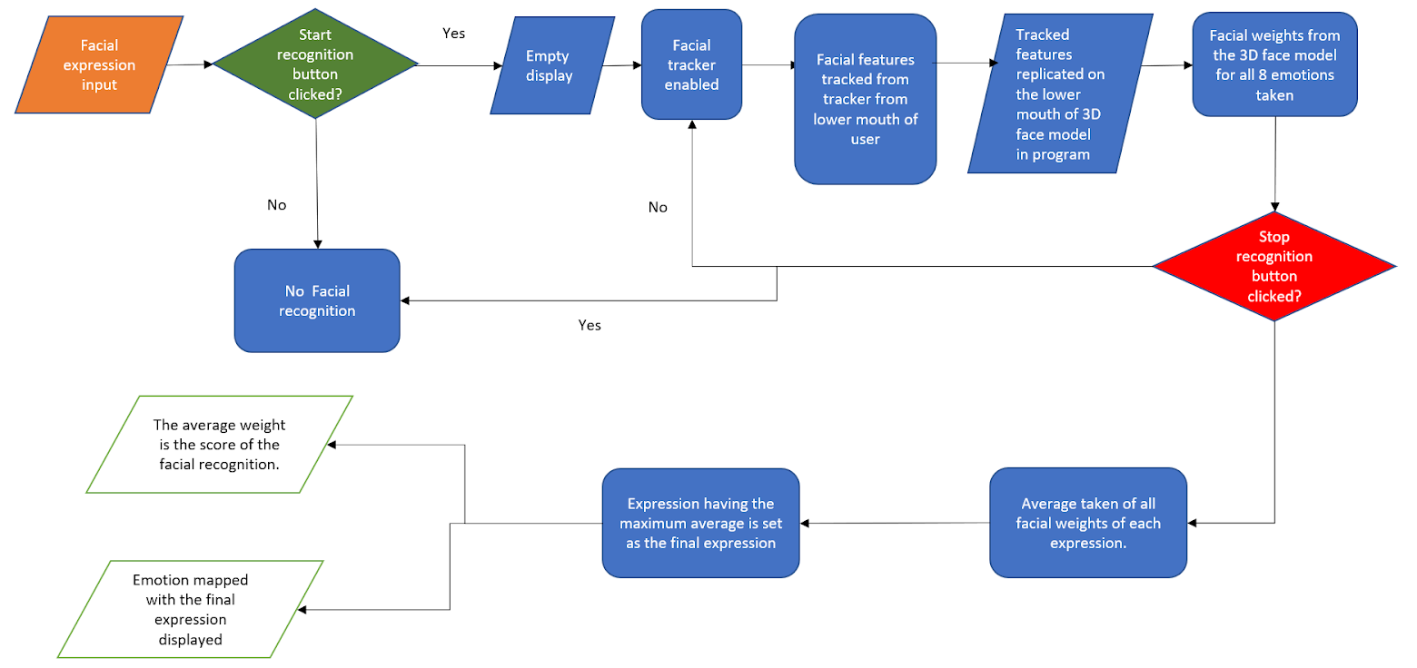
Recognize emotions from Face
Emotional recognition from face in brief

Slide 15
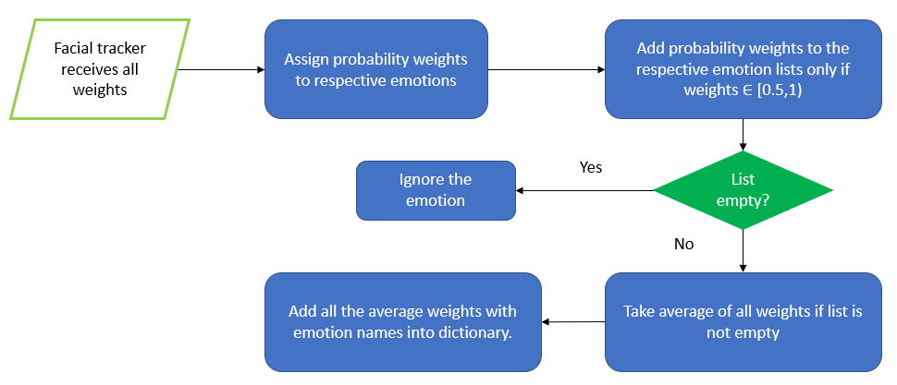
Recognize emotions from Face
Algorithm to calculate facial weights

Slide 16
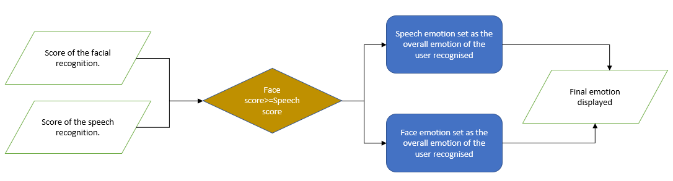
Return a suitable response in addition
Comparing scores, finalizing the emotion and displaying it

Slide 17
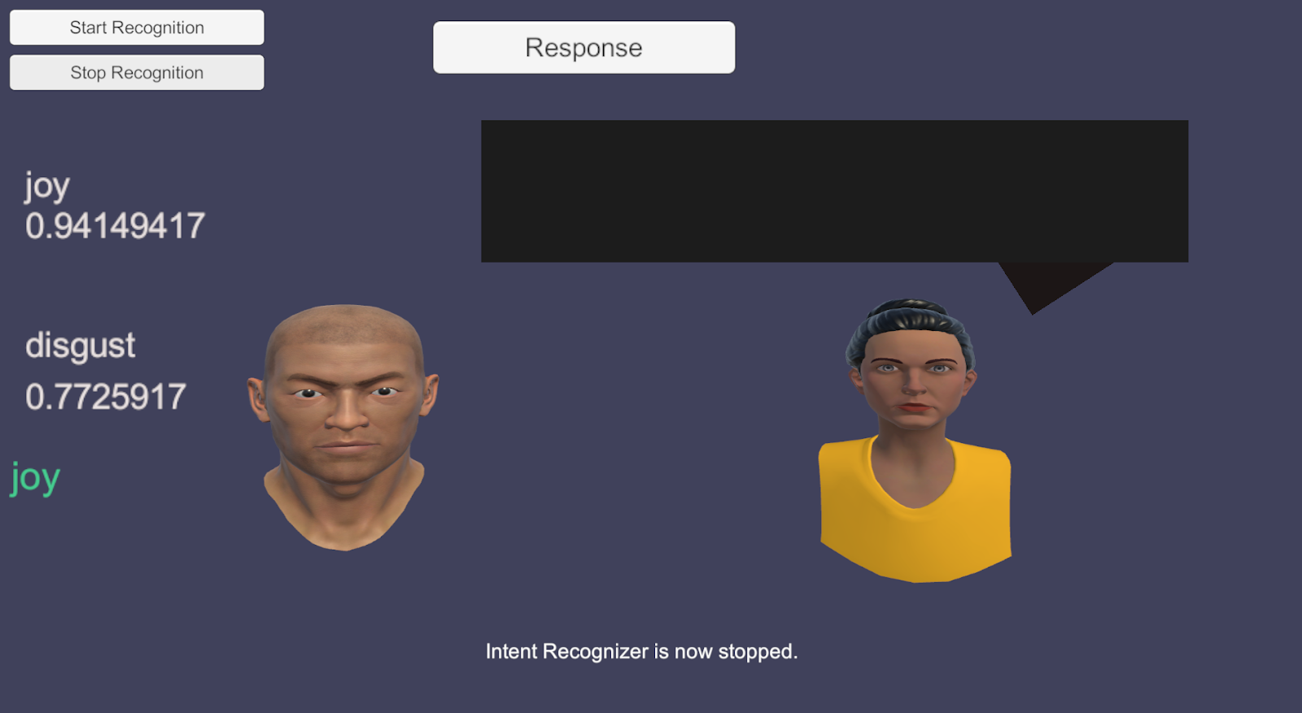
Return a suitable response in addition
Emotion from speech and speech score
Emotion from facial expression and face score
Final emotion displayed
Comparing scores, finalizing the emotion and displaying it

Slide 18
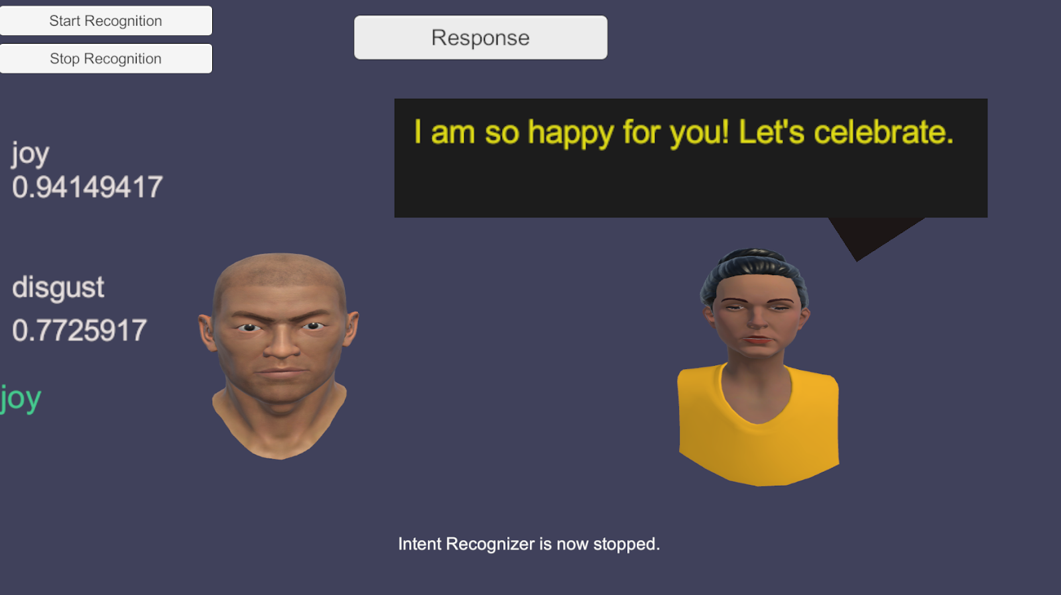
Return a suitable response in addition
Emotion from speech and speech score
Text response to corresponding emotion displayed
Emotion from facial expression and face score
Text converted to audio response lip synced by 3D avatar
Final emotion displayed
Comparing scores, finalizing the emotion and displaying it

Slide 19
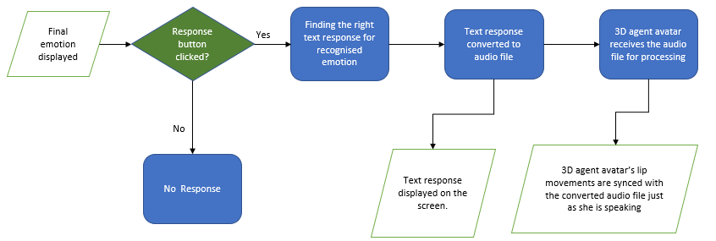
Return a suitable response in addition
Return a suitable response as per emotion detected, in brief

Slide 20
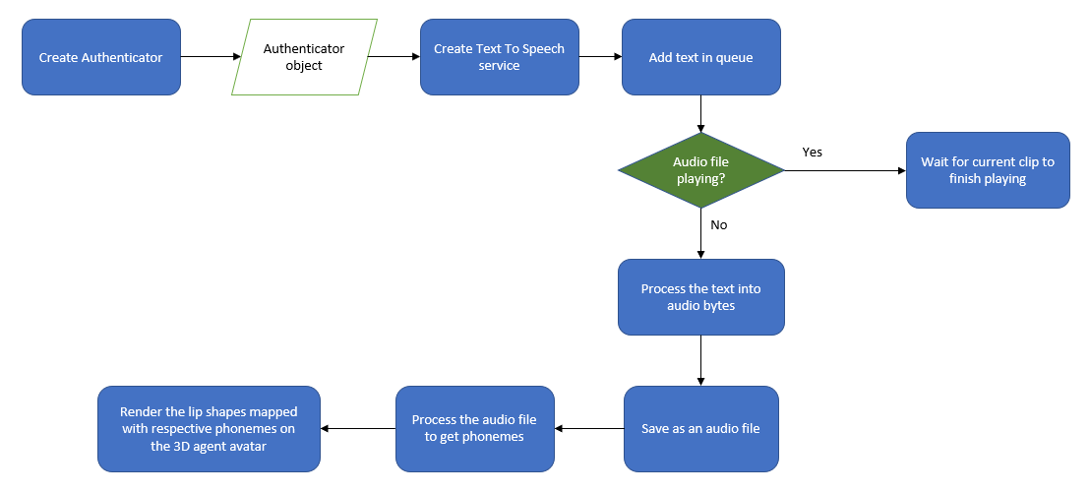
Return a suitable response in addition
IBM Watson Cloud TTS conversion and lip sync with avatar

Slide 21

Demo Video
Demo Video Link Click here

Slide 22
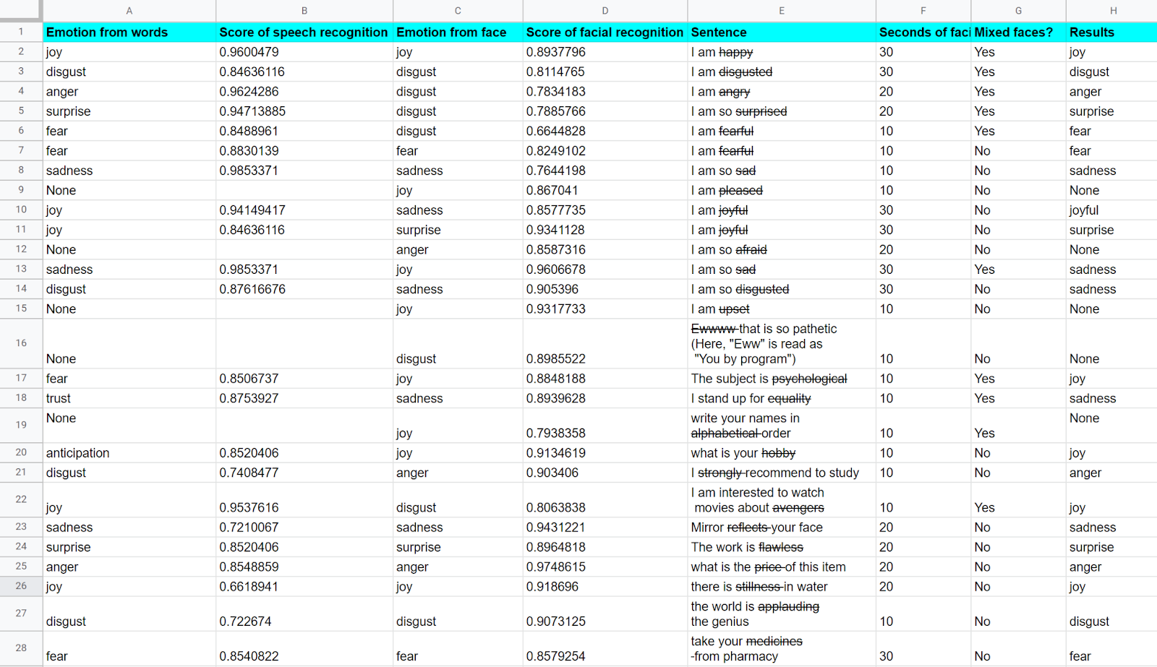
Results
Before adding 0.1 to face score
Unrecognised, as word not in database
After adding 0.1 to face score
incorrect recognition by program
Should be recognised as “anticipation”, but gone unnoticed
“avengers” an emotion of joy
“price” an emotion of anger
“applauding” an emotion of disgust

Slide 23
Impact
VR environment-alternative environment for self expression and understanding by the virtual agent.
Facial expressions also considered, instead of just speech as only channel.
Biggest impact- provide a new solution and direction in the ongoing research of affective awareness agents.

Slide 24
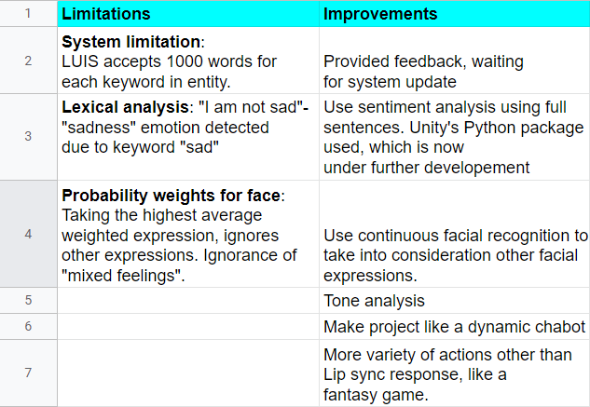
Future improvements
Existing limitations
Good to have features

Slide 25
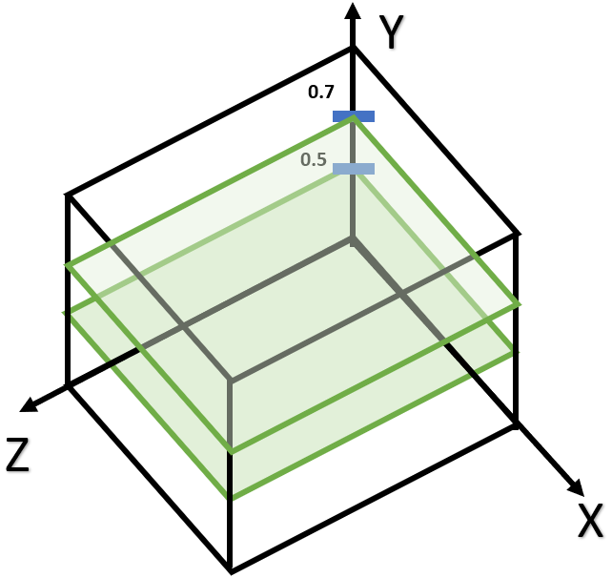
Discussion
Y=[0.5 , 0.7] :
Range for “joy” emotion
Planes enclosing regions for “joy” emotion
Plot data extracted from speech and facial recognition both in 3D space to find the overall emotion, instead of comparing the confidence scores.
More accurate- multi modal analysis, as an overall output is provided instead of considering only the higher weighted one.

Slide 26

Questions-Answers

Slide 27

Thank you, let’s immerse in VR!

